Slide 1
第八讲 结构、元组、枚举

Slide 2
内容
Structs Are Value Types
Constructors and Destructors
Field Initializers Are Not Allowed
Structs Are Sealed
Structs As Return Values and Parameters
Enumerations
Bit Flags
More About Enums

Slide 3
What Are Structs?
Structs are programmer-defined data types, very similar to classes. They have data members and function members

Slide 4
Classes and structs
Classes are reference types and structs are value types.
Structs are implicitly sealed, which means that they cannot be derived from.

Slide 5
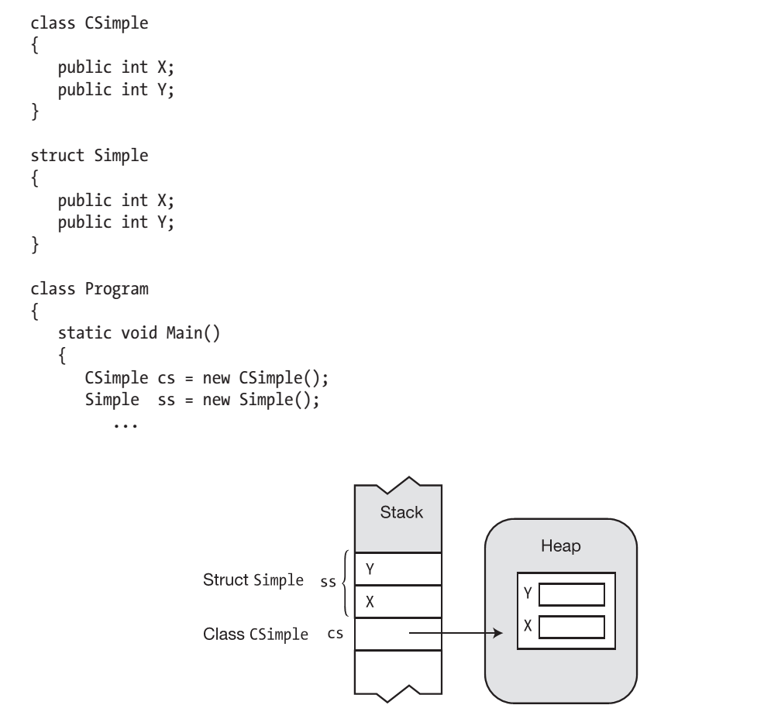
Demo

Slide 6
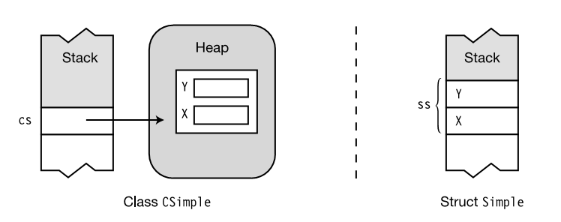
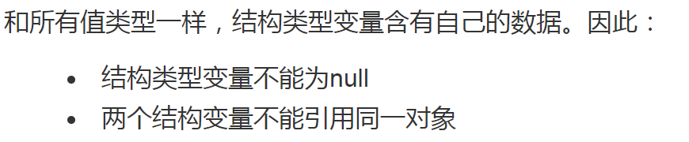
Structs Are Value Types
结构是值类型

Slide 7
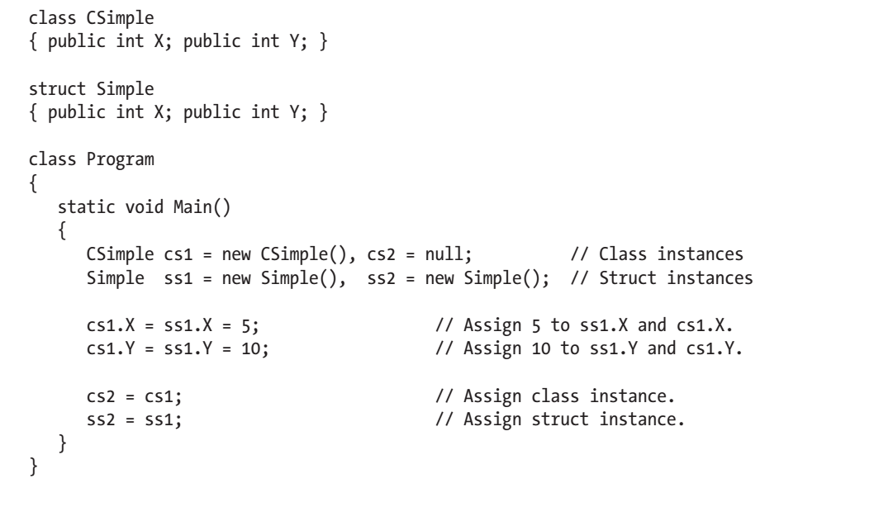
Assigning a class variable and a struct variable
Demo

Slide 8
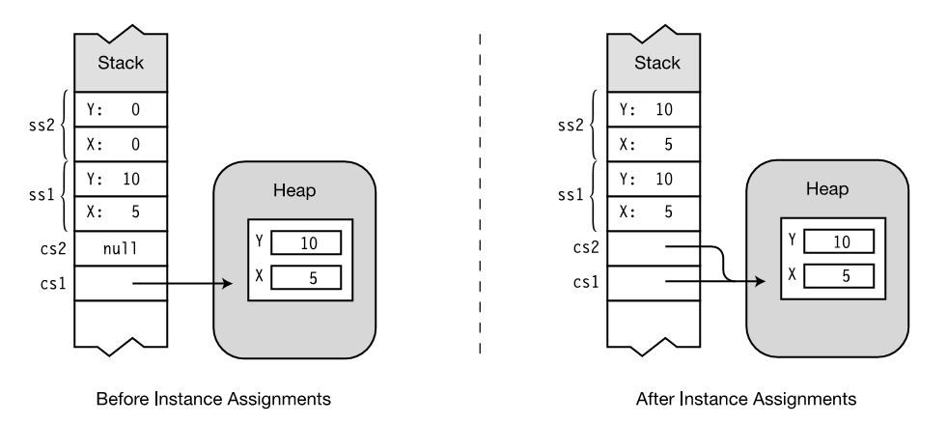

Slide 9
Constructors and Destructors
Structs can have instance and static constructors, but destructors are not allowed.

Slide 10
Instance Constructors
The language implicitly supplies a parameterless constructor for every struct.
The predefined parameterless constructor exists for every struct—and you cannot delete or redefine it.

Slide 11
Instance Constructors
You cannot use the value of a data member until you have explicitly set it.
You cannot call any function member of the struct until all the data members have been assigned.

Slide 12
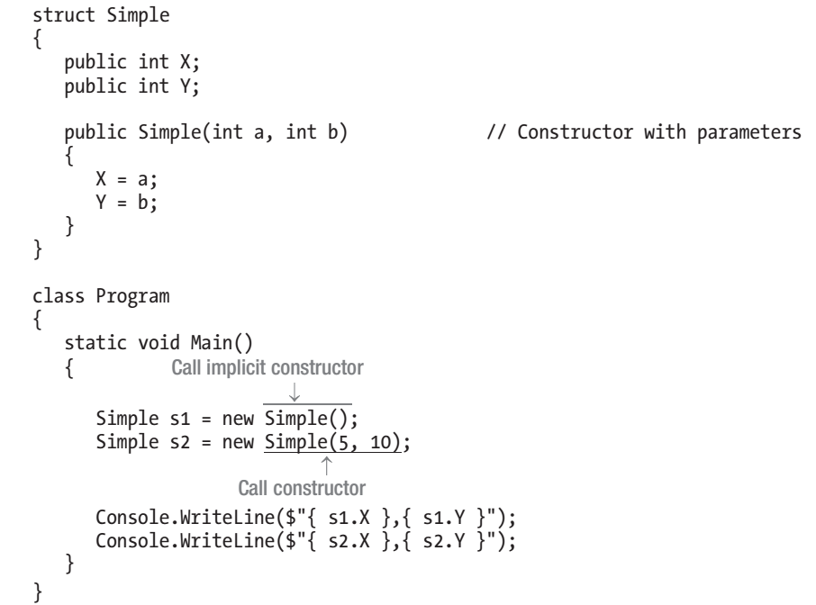
Instance Constructors
Demo

Slide 13
Static Constructors
As with classes, the static constructors of structs create and initialize the static data members, and cannot reference instance members.

Slide 14
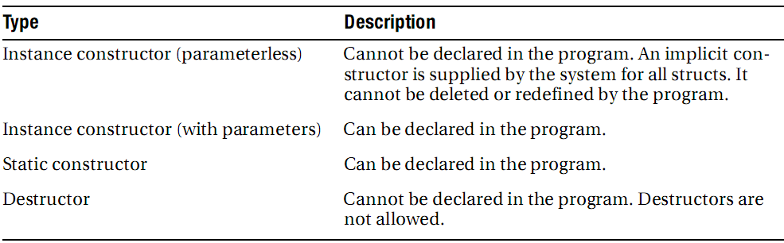
Summary of Constructors and Destructors

Slide 15
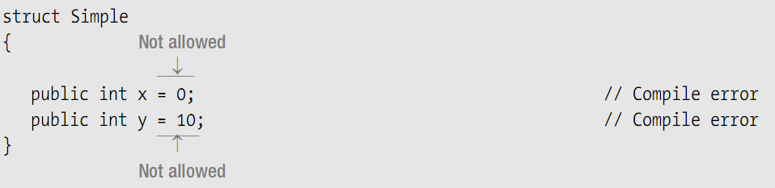
Field Initializers Are Not Allowed
字段初始化语句是不允许的

Slide 16
Structs Are Sealed
结构是密封的
The modifiers that cannot be used with structs are the following:
  protected
  internal
  abstract
  Virtual
The two inheritance-associated keywords you can use with struct members are the new and override modifiers, when creating a member with the same name as a member of base class System.ValueType, from which all structs are derived.

Slide 17
Structs As Return Values and Parameters
结构作为返回值和参数
Return value: When a struct is a return value, a copy is created and returned from the function member.
Value parameter: When a struct is used as a value parameter, a copy of the actual parameter struct is created. The copy is used in the execution of the method.
ref and out parameters: If you use a struct as a ref or out parameter, a reference to the struct is passed into the method so that the data members can be changed.

Slide 18
Additional Information About Structs
关于结构的其他信息
Allocating structs requires less overhead than creating instances of a class, so using structs instead of classes can sometimes improve performance—but beware of the high cost of boxing and unboxing.
The predefined simple types (int, short, long, etc.), although considered primitives in .NET and C#, are all actually implemented under the covers in .NET as structs.

Slide 19
Tuples and ValueTuples
C# 为用于说明设计意图的类和结构提供了丰富的语法。 但是，这种丰富的语法有时会需要额外的工作，但益处却很少。 你可能经常编写需要包含多个数据元素的简单结构的方法。 为了支持这些方案，已将元组 添加到了 C#。 元组是包含多个字段以表示数据成员的轻量级数据结构。 这些字段没有经过验证，并且你无法定义自己的方法

Slide 20
低于 C# 7.0 的版本中也提供元组，但它们效率低下且不具有语言支持。 这意味着元组元素只能作为 Item1 和 Item2 等引用。 C# 7.0 引入了对元组的语言支持，可利用更有效的新元组类型向元组字段赋予语义名称。

Slide 21
ValueTuple是C# 7.0的新特性之一，.Net Framework 4.7以上版本可用。
值元组也是一种数据结构，用于表示特定数量和元素序列，但是是和元组类不一样的，主要区别如下：
  值元组是结构，是值类型，不是类，而元组（Tuple）是类，引用类型；
  值元组元素是可变的，不是只读的，也就是说可以改变值元组中的元素值；
  值元组的数据成员是字段不是属性。

Slide 22
可以通过为每个成员赋值来创建元组，并可选择为元组的每个成员提供语义名称：
(string Alpha, string Beta) namedLetters = ("a", "b");
Console.WriteLine($"{namedLetters.Alpha}, {namedLetters.Beta}");
namedLetters 元组包含称为 Alpha 和 Beta 的字段。 这些名称仅存在于编译时且不保留，例如在运行时使用反射来检查元组时

Slide 23
在进行元组赋值时，还可以指定赋值右侧的字段的名称
var alphabetStart = (Alpha: "a", Beta: "b");
Console.WriteLine($"{alphabetStart.Alpha}, {alphabetStart.Beta}");

Slide 24
在某些时候，你可能想要解包从方法返回的元组的成员。 可通过为元组中的每个值声明单独的变量来实现此目的。 这种解包操作称为解构元组
(int max, int min) = Range(numbers);
Console.WriteLine(max);
Console.WriteLine(min);

Slide 25
还可以为 .NET 中的任何类型提供类似的析构。 编写 Deconstruct 方法，用作类的成员。 Deconstruct 方法为你要提取的每个属性提供一组 out 参数。 考虑提供析构函数方法的此 Point 类，该方法提取 X 和 Y 坐标：
public class Point
{
public Point(double x, double y)
=> (X, Y) = (x, y);
public double X { get; }
public double Y { get; }
public void Deconstruct(out double x, out double y) =>
(x, y) = (X, Y);
}
var p = new Point(3.14, 2.71);
(double X, double Y) = p;

Slide 26
可在元组相关文章中深入了解有关元组的详细信息
元组类型 - C# 指南 _ Microsoft Docs.pdf
详解C# Tuple VS ValueTuple（元组类 VS 值元组） - 永远薰薰 - 博客园.pdf

Slide 27
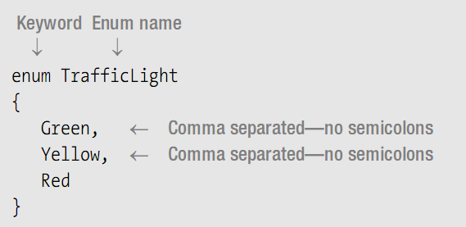
Enumerations
枚举
Like structs, enums are value types.
Enums have only one type of member: named constants with integral values.

Slide 28
Enumerations
Each enum member is assigned a constant value of the underlying type.
The compiler assigns 0 to the first member, and assigns each subsequent member the value one more than the previous member.

Slide 29
Demo

Slide 30
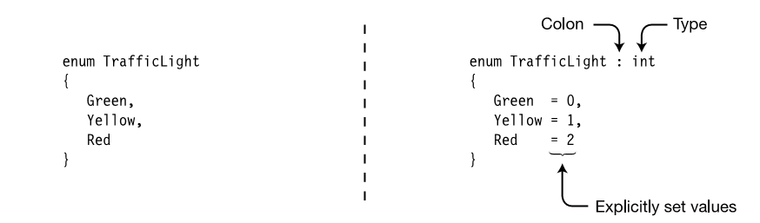
Setting the Underlying Type and Explicit Values设置底层类型和显式值
You can use an integral type other than int by placing a colon and the type name after the enum name. The type can be any integral type except char.

Slide 31
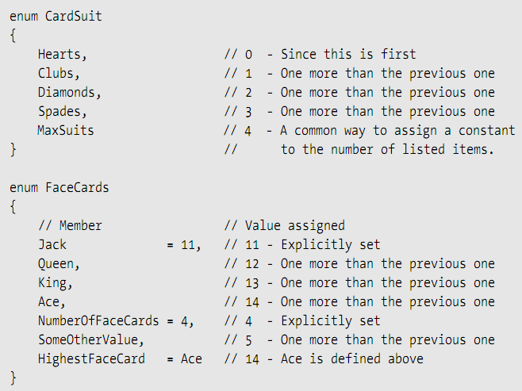
Implicit Member Numbering
隐式成员编

Slide 32
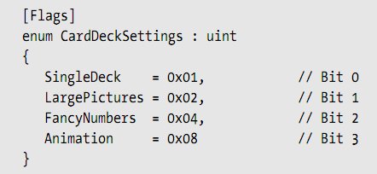
Bit Flags
位标志

Slide 33
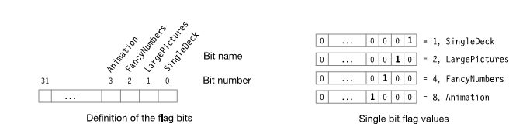
Definition of the flag bits, and their individual representations

Slide 34
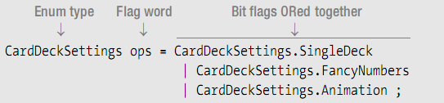
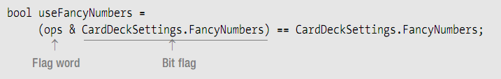
the bitwise OR,AND operator

Slide 35
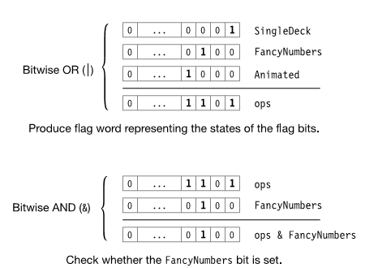

Slide 36
The Flags Attribute
Demo

Slide 37
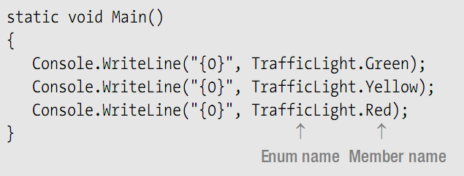
More About Enums
You cannot use modifiers with the members. They all implicitly have the same accessibility as the enum.
Since the members are constants, they are accessible even if there are no variables of the enum type.

Slide 38
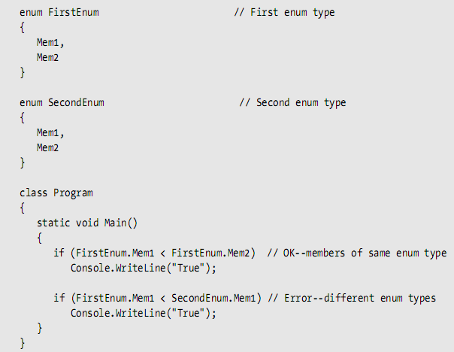
An enum is a distinct type. Comparing enum members of different enum types results in a compile-time error.

Slide 39


终于
结束啦！

